Slide 1



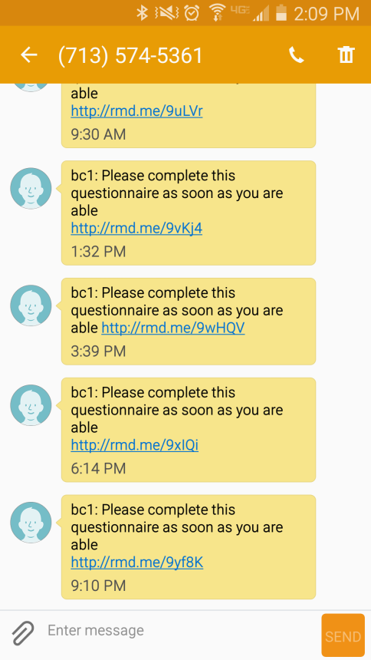
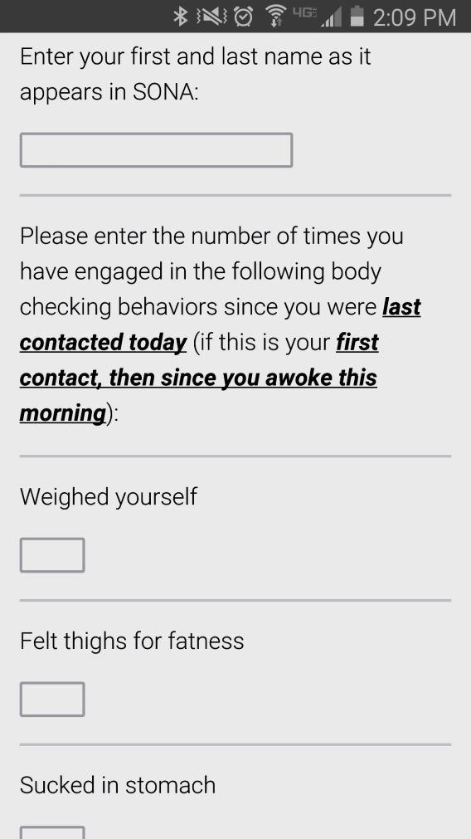
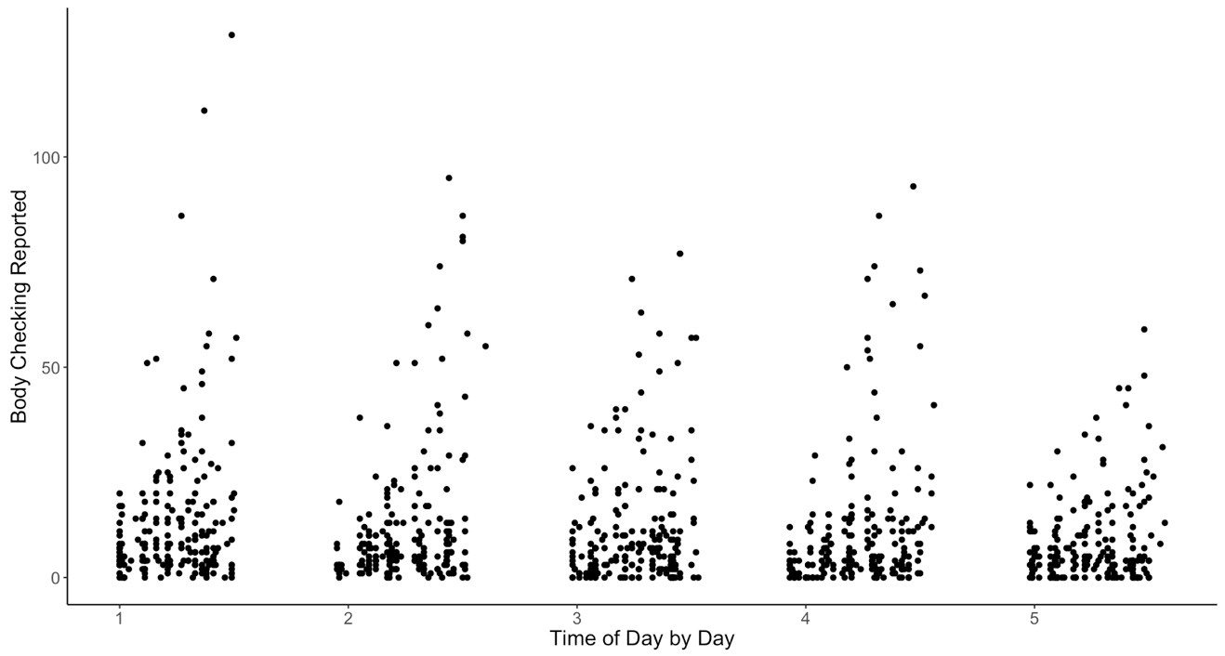



Examination of a Five-Day Ecological Momentary Intervention on Body Checking: An Update
Jamie M. Smith¹, M.S., Jen A. Battles², M.S., Brooke L. Whisenhunt³, Ph.D.,
Erin M. Buchanan³, Ph.D. and Danae L. Hudson³, Ph.D.
1.
2.
3.
Body checking has been identified as a maintaining factor for those with eating disorders. While a number of experimental studies have demonstrated the role body checking has in maintaining body dissatisfaction, few studies have focused on specific treatments for body checking. The current study utilized Ecological Momentary Assessment/ Intervention (EMA/EMI) to evaluate a digital intervention targeting body checking. Forty-four undergraduate female participants in the study received five messages per day for five total days asking them to report on the number of times they had engaged in body checking behaviors. On days four and five, participants also received a total of five interventions delivered at every other time point. Multilevel analyses revealed that body checking behaviors increased within each day, but decreased across the five-day intervention period. These results indicate a decrease in body checking across the five-day intervention period; however, no significant decrease directly following intervention prompts. These results suggest the feasibility of brief EMI as a useful clinical tool and reveal that evenings may be a particularly high-risk time for body checking behaviors.
Multilevel modeling was used to investigate the relationship between time (within day and across days), body dissatisfaction, and reported body checking.
Analyses revealed that body checking behaviors increased within each day (b’s = 11.51 – 27.28, p’s < .001), but decreased across the five-day intervention period (b = -1.07, p < .001). Body checking behaviors directly following intervention prompts on days four and five were not significantly impacted (b = 0.28, p = .86).
Figure 1. Body checking frequency by time of day.
Abstract
Results
Below are the five interventions consisting of psychoeducation, visualization, and cognitive-behavioral strategies to reduce checking:
Interventions
“Think of a time in your life when you were checking your body a lot. Reflect
on how you felt about your body overall during that time period. Research
has shown that when people engage in a lot of body checking, they actually tend to focus more on their bodies and become more preoccupied with their shape and weight. Think about whether this is true for you. How do you feel about your body when you engage in a lot of body checking?”
Body checking, such as looking in the mirror and weighing oneself, (Shafran et al., 2007) has been identified as a maintaining factor for those with eating disorders by increasing body dissatisfaction and body-related self-critical thoughts (Fairburn, 2008; Shafran et al., 2007; Smeets et al., 2011; Walker, 2014).
Currently, no studies have addressed digital treatments for body checking behaviors.
EMI is an intervention delivered with mobile technology to individuals in their naturalistic environments and has been shown to positively impact health behaviors such as smoking cessation and weight control (Heron & Smyth, 2010; Patrick et al., 2009).
Hypotheses
Body checking would decrease across the five-day intervention.
Body checking would decrease directly following intervention prompts on days four and five.
Participants & Measures
44 female undergraduates, Mean age = 18.39 (SD = 0.58)
White: n = 40 (90.9%), African American: n = 2 (4.5%), Other: n = 3 (6.8%)
Mean BMI = 21.83 (“healthy” range, SD = 1.88)
Body checking behaviors (8 common behaviors from Stefano, et al., 2016)
Procedures
Participants qualified for five day EMI if they were healthy weight, had smart phones, and had high trait levels of body checking
Completed five experimental days, received EMA measure prompt 5x daily
During the fourth and fifth day, participants also received an intervention at every other time point
Introduction & Method
“Imagine yourself standing in front of a full length mirror wearing only a
swimsuit. Now, think about focusing on all the parts of your body that you
dislike. What would your mood and feelings about your body be like after doing this? Compare this imaginary experience to what occurs when you engage in a lot of body checking. How are those experiences similar or different?”
These results indicate a decrease in body checking across the five-day intervention period; however, no significant decrease directly following intervention prompts.
Additionally, body checking was unexpectedly found to increase throughout the course of each individual day:
Although the interaction between day and time of day was not “significant” by traditional standards (p = 0.085), we explored the simple slopes within each day, as this pattern of daily increases in body checking has not been seen in the literature.
The daily body checking slopes decreased in magnitude from day one to five, therefore, in addition to the overall decrease in body checking across the five days, the overall magnitude of increased body checking within each day, also decreased.
These results suggest the feasibility of brief EMI as a useful clinical tool and reveal that evenings may be a particularly high-risk time for body checking behaviors.
Active control groups compared to EMA only groups should be considered in future studies to better understand the impact of the intervention.
Discussion
“Body checking is very common and not necessarily bad. When you’re
getting dressed, you often want to check your body in a mirror. On the other
hand, there are also times when people can experience unwanted urges to check their bodies. For example, feeling the urge to weigh yourself frequently may become problematic. Techniques such as deep breathing can help you to ‘ride out’ an urge until it fades. Deep breathing involves inhaling for a count of four, holding for a count of two and exhaling for a count of four, holding for a count of two, and repeating. Identify two checking urges that you will attempt to resist by using deep breathing in the next day.”
“Many strategies can be used when an unwanted urge to check your body
occurs. Cognitive challenging is one of these strategies. When you have an
unwanted urge to check, you can try repeating to yourself “checking will only make me want to check more” and/or “this too shall pass”. How do you think it would feel to use this technique? What could you say to yourself the next time you have an unwanted urge to check?”
References
Fairburn, C. G. (2008). Cognitive behavior therapy and eating disorders. New York, NY: The Guilford Press.
Heron, K. E., & Smyth, J. M. (2010). Ecological momentary interventions: Incorporating mobile technology into psychosocial and health behaviour treatments. British Journal Of Health Psychology, 15(1), 1-39. doi:10.1348/135910709X466063
Shafran, R., Lee, M., Payne, E., & Fairburn, C. (2007). An experimental analysis of body checking. Behaviour Research And Therapy, 45(1), 113-121.
Smeets, E., Tiggemann, M., Kemps, E., Mills, J. S., Hollitt, S., Roefs, A., & Jansen, A. (2011). Body checking induces an attentional bias for body‐related cues. International Journal of Eating Disorders, 44(1), 50-57.
Stefano, E. C., Hudson, D. L., Whisenhunt, B. L., Buchanan, E. M., & Latner, J. D. (2016). Examination of body checking, body image dissatisfaction, and negative affect using ecological momentary assessment. Eating Behaviors, 22, 51-54. doi: 10.1016/j.eatbeh.2016.03.026
Walker, D. C. (2014). An experimental manipulation of body checking and mirror exposure over time in men and women with high shape or weight concern (Doctoral Dissertation). Retrieved from Dissertation Abstracts International: Section B: The Sciences and Engineering. (Accession No. 2014-99101-021)
“Imagine you are having coffee with a close friend. This friend appears fit
and physically active. She shares with you how bad she feels about her body.
She tells you how long it takes her to get ready in the morning because of how often she changes clothes and examines herself in the mirror. She describes... Think about what type of things you would tell this friend regarding her constant mirror checking and checking of her stomach. What would you tell this friend about her checking behaviors (mirror checking, sucking in stomach, and feeling stomach)? Would you tell her to do anything differently?”
For more information, contact Jamie Smith at Jamie999@unm.edu

